Slide 1
Dynamic Normalization Network
How can we achieve global image normalization through local (pixel-wise) interactions?
Could this mechanism account for some brightness/lightness illusions?

Slide 2
Differential equations intro
Differential equations allow for the computation of a system’s evolution based purely on the initial conditions and the defined dynamics of the system.
In this case, the diffusion equation satisfies the dynamics which we desire, that is, a spatially-discrete processing mechanism in 2D.
Within this equation, we can design operators which change the dynamics and in this way change how the system evolves.

Slide 3

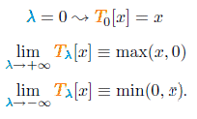
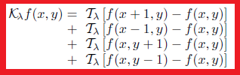
Diffusion equation prerequisites
The diffusion equation is steered to different dynamics by λ parameter.
λ in turn dictates how the T operator functions.
T operator states either no operation, half-wave rectification or inverse half-wave rectification (to be discussed later).
K operator applies T operation to the nearest neighborhood of each pixel in the image.

Slide 4
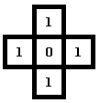
K operator walk-through
If we choose λ=-inf, then T(λ) becomes min(x,0) which operates upon the neighborhood of each pixel.
This operator asks “is x smaller than 0?”, if yes return x, if not return 0.
Using the local surround above, where (0,0)=0, we find Kf(0,0) = min(1,0)+min(1,0)+min(1,0)+min(1,0) = 0. Therefore local minimum is preserved.
If we choose λ=+inf, then T(λ) becomes max(x,0) and Kf(0,0) = 4, through the opposite computation. Therefore local minimum value, 0, has been “eaten” or overwritten by the local surround.
In this way a local operation results in a global average. Either in the λ=-inf or λ=+inf states (or else can be described as the lightness diffusion layer and darkness diffusion layer)

Slide 5



The diffusion equation
K operator is a component of the full diffusion equation
Generic form of diffusion equation
Two diffusion states: “a” applies minimum operator (where, λ=-inf) upon local surround, “b” applies maximum operator (where, λ=+inf) upon local surround.
At time zero, the solution of the diffusion equation is simply the input stimuli, and as time evolves, the nearest neighborhood interactions develop the two diffusion layers a and b, “darkness and lightness diffusion layers”.

Slide 6
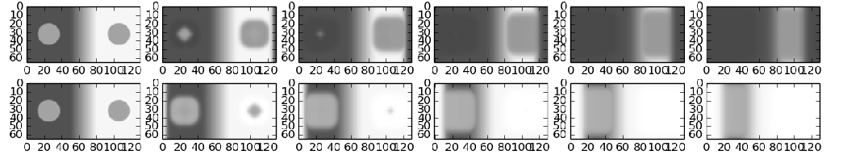
Visualising the diffusion layers
The diffusion equations are solved using the 4th order Runga-Kutta method.
(let me know if you want more in-depth explanation of this method, but in short it finds solutions to differential equations). There are simpler ways to solve differential equations, but this is the most robust and accurate.
Below are some solutions to a&b, the diffusion state equations.
a
b
t
In a, the darkness diffusion layer, it can been seen that darker pixels “eat” lighter pixels resulting in the growth of local darkness.
In b, the lightness diffusion layer, it can be seen that lighter pixels “eat” darker pixels, resulting in the growth of local lightness.
From finding the “zero state luminance” (darkest value) and “one state luminance” (lightest value), we can go onto normalise the initial image.

Slide 7
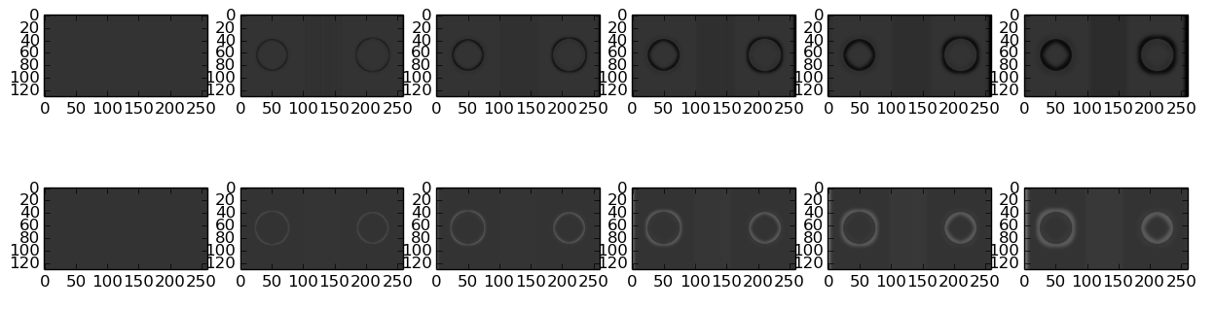
Change in diffusion layers over time
If instead of viewing the solutions at each time step we visualise the change in solutions as compared to the initial time step, we see a different pattern emerging.
Namely, within the darkness layer (a) the surround of the right patch darkens whilst the inner of the left patch darkens, with the inverse happening in the lightness diffusion layer – lightening within the right patch, lightening of outer edge of left patch.
a
b

Slide 8


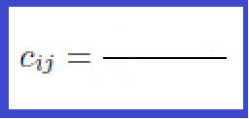
Recombining the two diffusion layers to generate a normalized image
The solutions to the two diffusion equations (darkness diffusion layer, brightness diffusion layer) are then recombined to generate a normalized image, using the below equation (step-by-step next slide).
This is the full dynamic solution, derived from the steady-state solution.
This is equivalent to a linear scaling scheme used for scaling a fixed set of numbers (see bottom fig eq.).
The benefit of having a full dynamic equation means we can avoid the singularity at b=a.
So the two equations are applicable under different circumstances, but ultimately model the same process... normalisation.
stimuli scaled to zero. i.e. subtract the stimuli by darkness diffusion layer, or minimum value, a.
luminance range between darkness and lightness layers (i.e. luminance range)

Slide 9
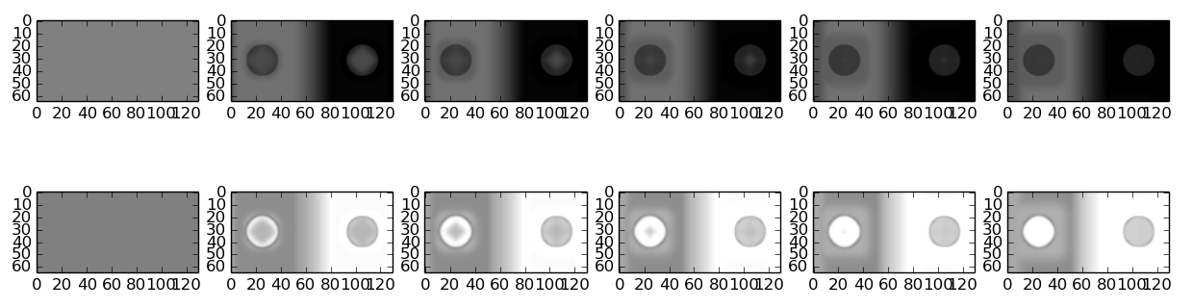
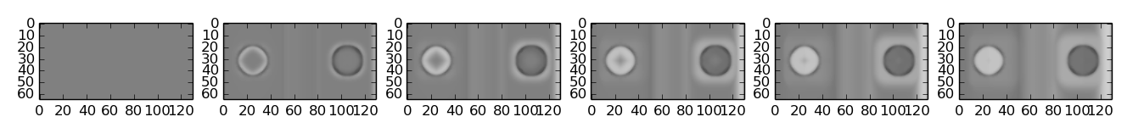
Intermediate steps – plotted components
Top “b(0-c)”, middle “-a(1-c)” and bottom “b(0-c)-a(1-c)”
Intuitive understanding of these parts is rather difficult. Almost a process computes the difference between the two diffusion layers and recombines with the stimuli. Nevertheless we can observe correct directional lightness changes in the patches (lightening left, darkening right in the bottom two figure).
t

Slide 10

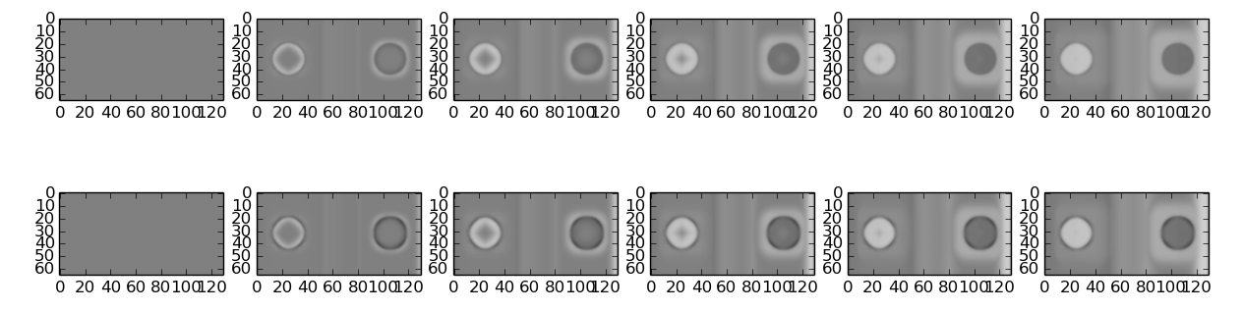
Change in normalized output over time
The steady-state solution is on the top, whilst the full dynamic solution is plotted on the bottom.

Slide 11
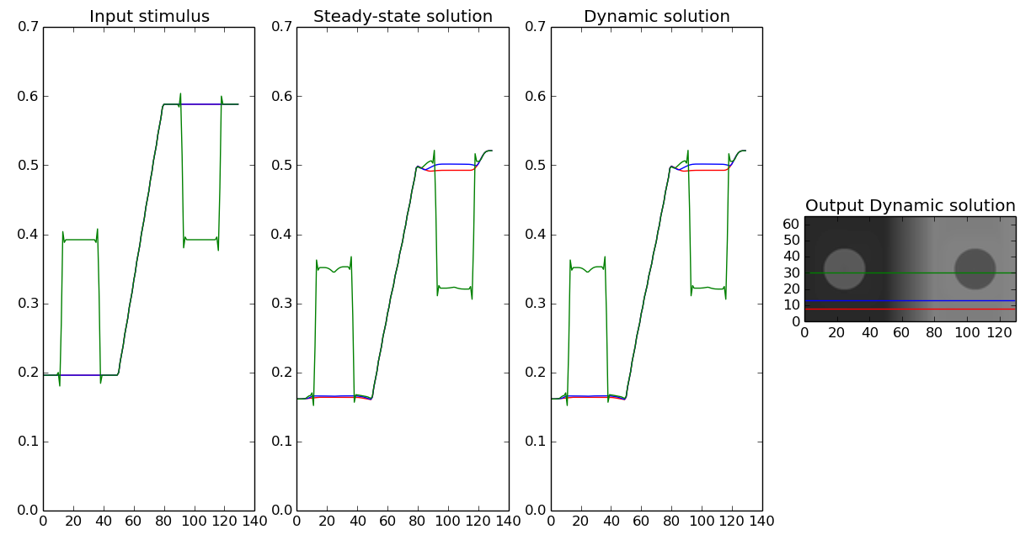
Profile of Outputs
We can observe physical luminance change.

Slide 12
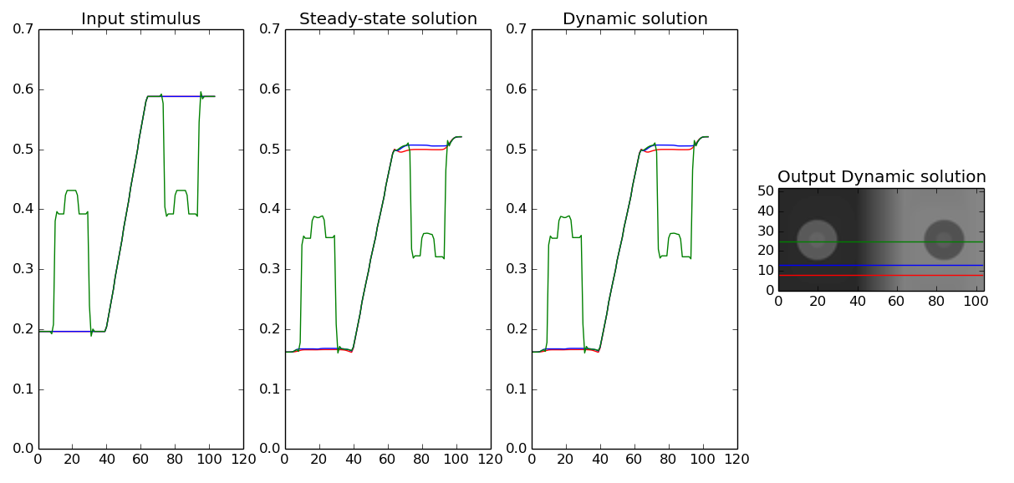
Internal patch
Also, occurs for internal patches

Slide 13
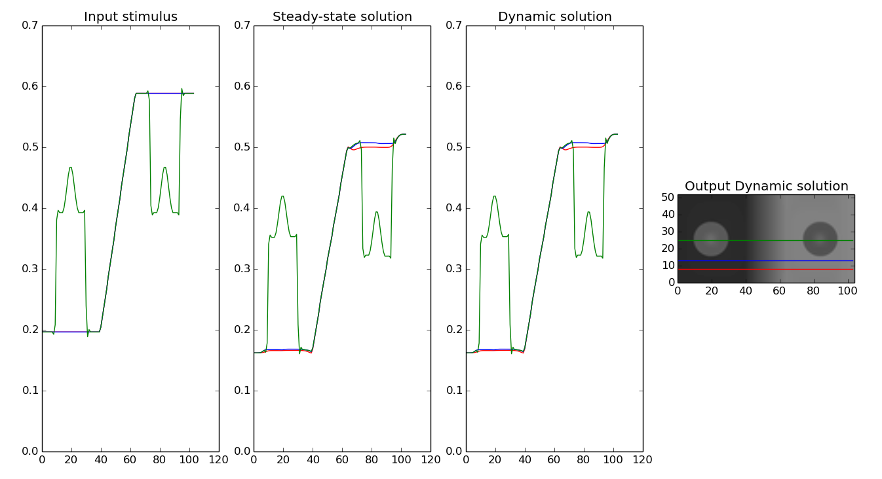
Internal Patch Blurred
Also occurs for blurred internal patches

Slide 14

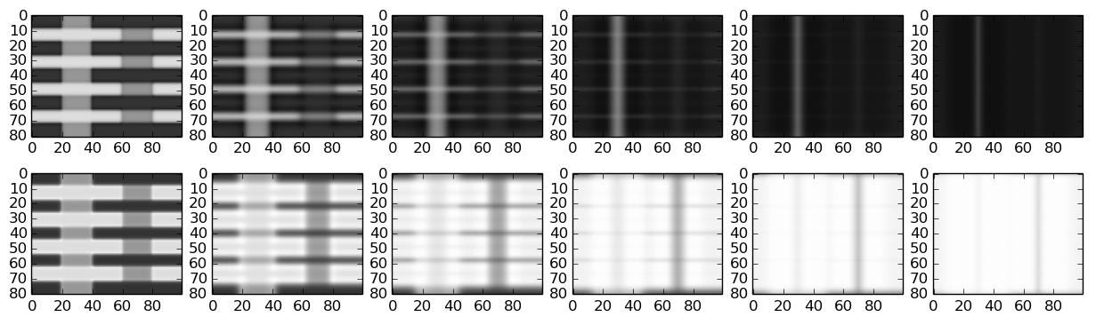
White's
The normalisation scheme fails for White's illusion, lets try to understand why.
If we consider the steady state solution for one of the left hand (perceived lighter gray) patches. For our test patch we observe brightening in brightness layer (b), darkening in darkness layer (a). E.g. luminance scale 0<L<1: s=0.5, a = 0.3, b =0.7 => c = 0.2/0.5=0.4. So it incorrectly predicts a darkening of the left patches.
So the luminance change goes in the wrong direction in the diffusion layers. This is probably due to the greater quantity of dark local surround to the left patches. Let's try different WI.
a
b

Slide 15
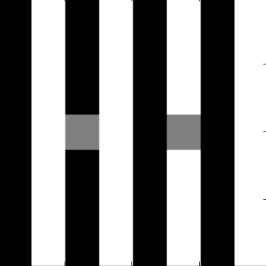
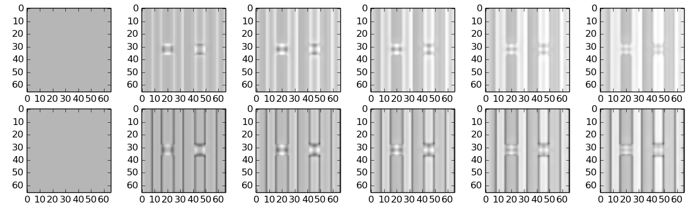
White's
Changing the context of the test patch to the stimuli on the right, we can see if it works under different image compositions.
It can be observed that equivalent, darkening “fills-in” from the dark edges and lightening “fills-in” from the light edge resulting in no physical change in the luminance.
In short (as we saw for the previous stimuli), for whites illusion, the quantity of dark/light edges dictates the change luminance in the normalized image. More dark edges → more lightening.

Slide 16
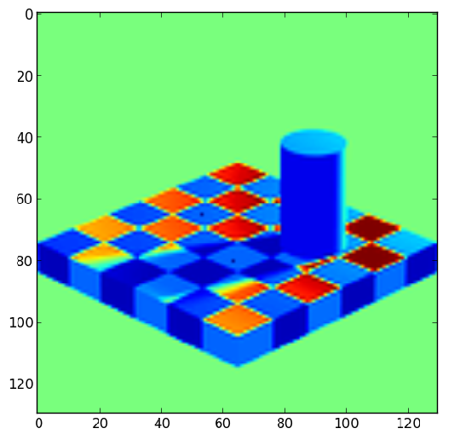
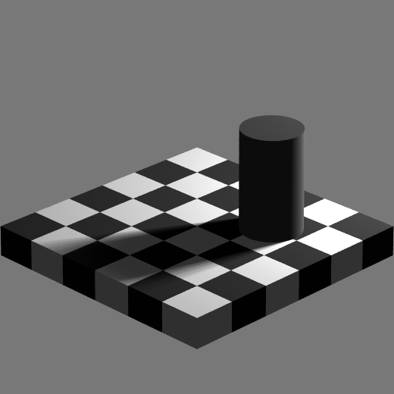
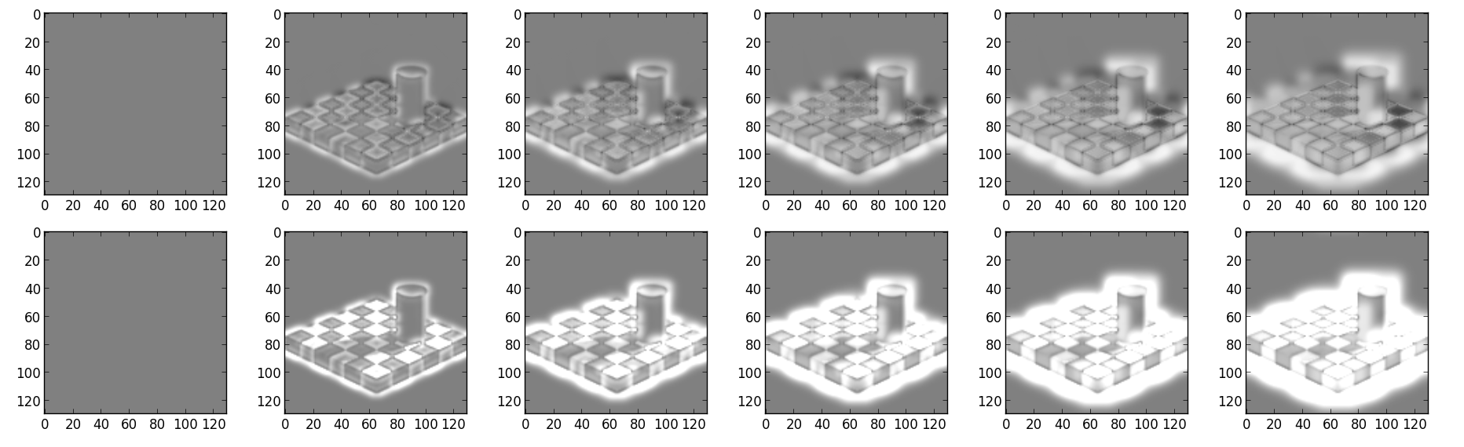
Adelson
No change in difference between test checks

Slide 17
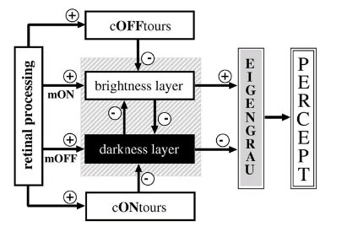
In context of full model
Viewed current output represent end point of normalization process or “brightness layer” diffusion filling-in, also ON-type contrast

Slide 18
Possible future work
Combined with edge detection & FIDO code from Francis model to average normalized change within edge domains.
Build on description of why White's fails and why SBC works.
Expand model with cONtours & cOFFtours

Slide 19
Conclusions
Need to confirm stability of output at high diffusion coefficient values
Questionable neurophysiological plausibility
Fails for Adelson's & White's
Luminance information “fills-in” from contrast edges (see real world videos)
Lightness effects observed in SBC with inner patches

